Slide 1
Elasticity and Its Applications

Slide 2
Elasticity measures the responsiveness of quantity demanded and quantity supplied to changes in price, influencing pricing decisions, revenue management, and market dynamics.

Slide 3
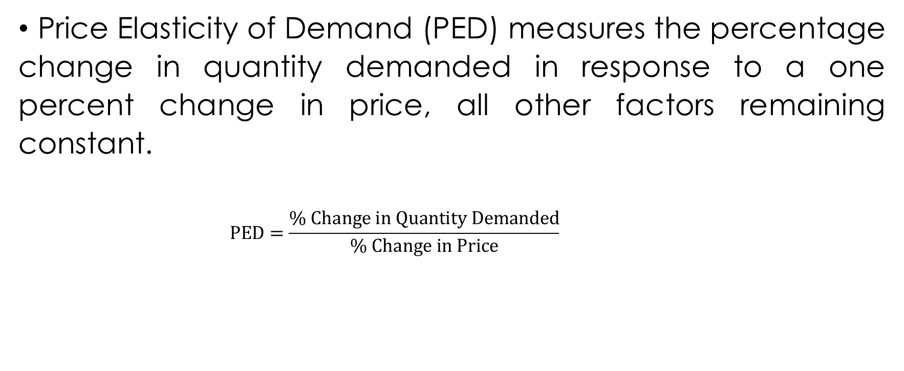
Price Elasticity of Demand (PED)
Price Elasticity of Demand (PED) measures the percentage change in quantity demanded in response to a one percent change in price, all other factors remaining constant.
$$PED=\frac{\% Change in Quantity Demanded}{\% Change in Price}$$

Slide 4
Interpretation of Price Elasticity Coefficients

Slide 5
Elastic Demand: PED > 1
Percentage change in quantity demanded is greater than the percentage change in price.
Consumers are responsive to price changes.
e.g. Luxury goods

Slide 6
Unitary Demand: PED = 1
Percentage change in quantity demanded is equal to the percentage change in price.
Total revenue remains constant when price changes.
e.g. Agricultural products with many substitutes.

Slide 7
Inelastic Demand: PED < 1
Percentage change in quantity demanded is less than the percentage change in price.
Consumers are less responsive to price changes.
e.g. Necessities, essential goods.

Slide 8
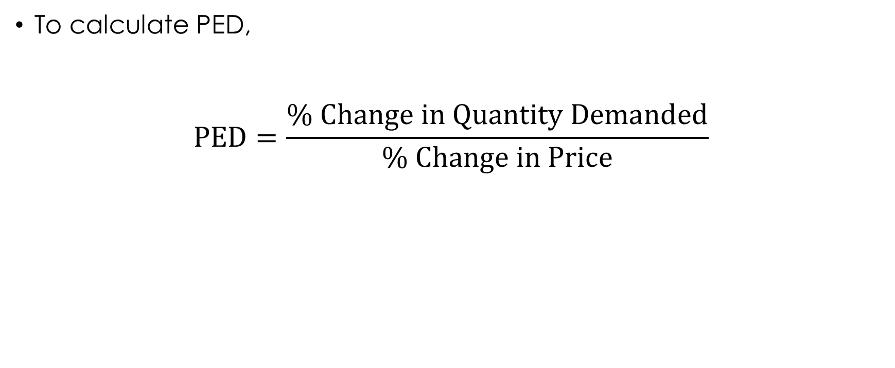
Calculating of Price Elasticity of Demand
To calculate PED,
$$PED=\frac{\% Change in Quantity Demanded}{\% Change in Price}$$

Slide 9
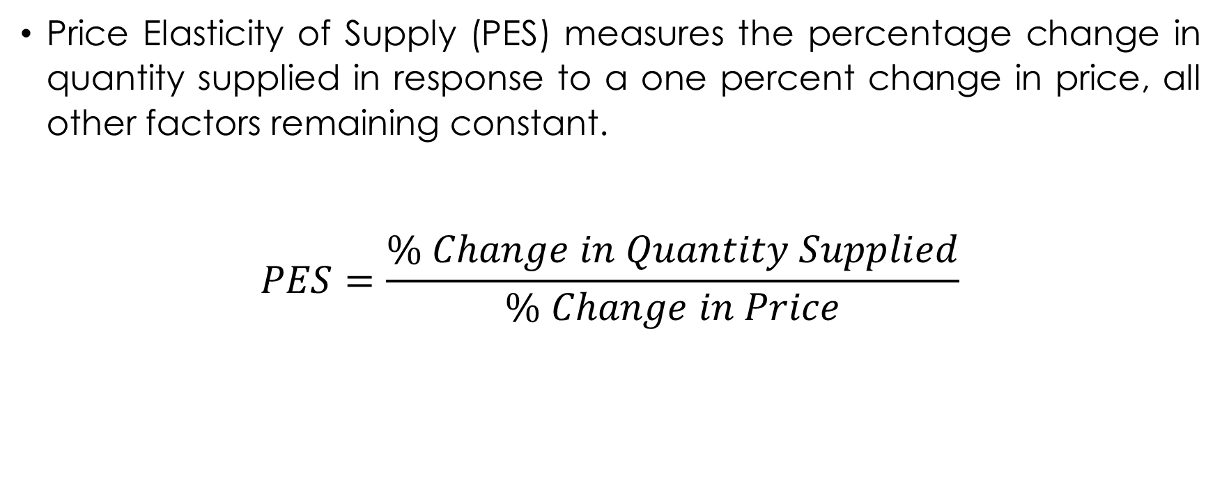
Price Elasticity of Supply (PES)
Price Elasticity of Supply (PES) measures the percentage change in quantity supplied in response to a one percent change in price, all other factors remaining constant.
$$PES=\frac{\% Change in Quantity Supplied}{\% Change in Price}$$

Slide 10
Interpretation of Price Elasticity of Supply Coefficients

Slide 11
Elastic supply: PES > 1
Producers are responsive to price changes.
Percentage change in quantity supplied is greater than the percentage change in price.
e.g. Agricultural products with short production periods

Slide 12
Unitary Elastic Supply: PES = 1
Percentage change in quantity supplied is equal to the percentage change in price.
e.g. Some raw materials.

Slide 13
Inelastic Supply: PES < 1
Producers are less responsive to price changes.
Percentage change in quantity supplied is less than the percentage change in price.
Agricultural products with long production periods.

Slide 14
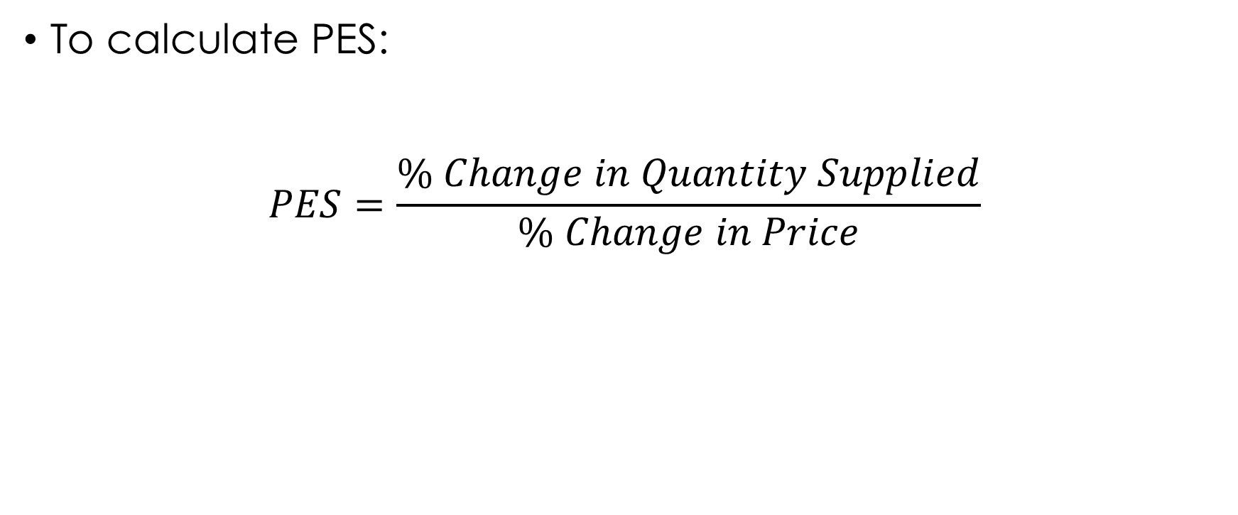
Calculating of Price Elasticity of Supply
To calculate PES:
$$PES=\frac{\% Change in Quantity Supplied}{\% Change in Price}$$

Slide 15
Income Elasticity of Demand (XED)
Income elasticity of demand (YED) is a crucial concept in economics that measures how the quantity demanded of a product or service changes in response to changes in consumers' income levels.
It provides valuable insights into how sensitive consumer demand is to fluctuations in income.

Slide 16
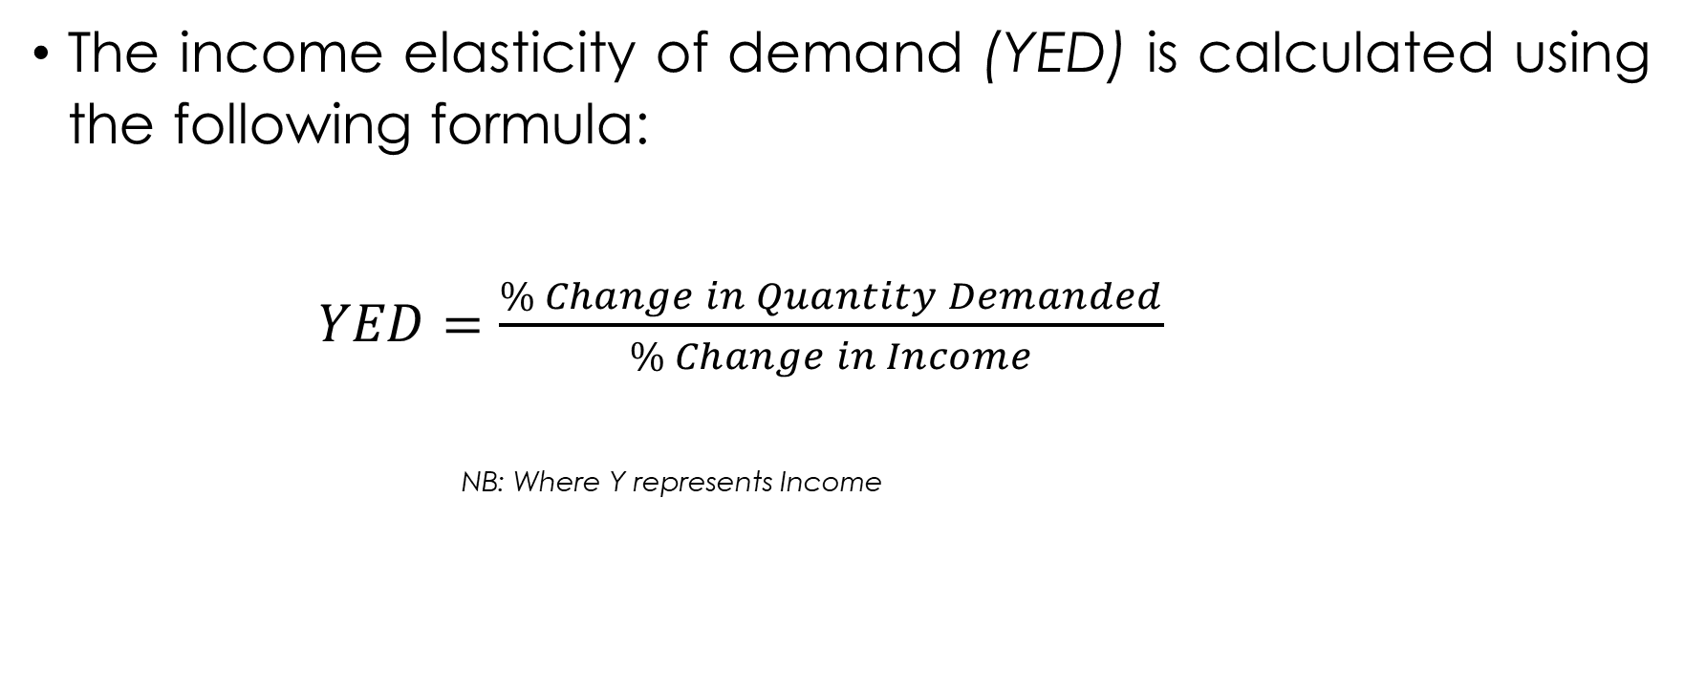
Calculating Income Elasticity of Demand:
The income elasticity of demand (YED) is calculated using the following formula:
$YED=\frac{\% Change in Quantity Demanded}{\% Change in Income}$
NB: Where Y represents Income

Slide 17
Interpreting Income Elasticity of Demand:
Positive Income Elasticity (YED > 0):
YED > 1: Indicates a luxury or superior good. As consumers' income increases, the demand for such products increases at a proportionally higher rate.
VCA need to recognize the importance of these goods in the market and explore opportunities to cater to consumers' changing preferences as income rises.
0<YED<1: Represents a necessity. As consumers' income increases, the demand for these goods also increases, but at a proportionally lower rate.
VCA professionals need to be aware of the significance of these goods for different income groups and identify potential shifts in demand patterns.

Slide 18
2. Negative Income Elasticity (YED < 0):
Indicates an inferior good. As consumers' income rises, the demand for such products decreases.
VCA students must recognize the impact of income changes on the demand for inferior goods and identify strategies to adapt to evolving consumer preferences.

Slide 19
3. Zero Income Elasticity (YED = 0):
Represents income-inelastic goods. The quantity demanded remains constant regardless of changes in income.
Individuals should be aware of the stability of demand for these goods, as it helps in planning and managing supply chains.

Slide 20

Cross Elasticity of Demand (XED)
Cross elasticity of demand measures the responsiveness of the quantity demanded of one good to changes in the price of another related good.
XED helps to understand how the demand for a particular good is influenced by the price changes of another good.
Cross elasticity of demand is calculated using the following formula:
$$XED=\frac{\% Change in Quantity Demanded of Good A}{\% Change in Price of Good B}$$

Slide 21
Interpretating cross elasticity
The cross elasticity of demand can be classified into three categories based on the sign of the value obtained:

Slide 22
1. Positive Cross Elasticity (Substitutes)
A positive cross elasticity of demand indicates that the two goods are substitutes for each other.
This implies that an increase in the price of one good leads to an increase in the quantity demanded of the other, and vice versa.
E.g. If the price of tea increases, the demand for coffee might also increase, as consumers switch to the cheaper alternative.

Slide 23
2. Negative Cross Elasticity(Complements)
A negative cross elasticity of demand suggests that the two goods are complements, meaning they are consumed together.
A negative cross elasticity means that an increase in the price of one good leads to a decrease in the quantity demanded of the other, and vice versa.
E.g. If the price of smartphones increases, the demand for smartphone cases might decrease, as fewer people would be willing to buy smartphones without protective cases.

Slide 24
3. Zero Cross Elasticity (Unrelated Goods)
If the cross elasticity of demand is zero, it indicates that the two goods are unrelated, and changes in the price of one good have no impact on the quantity demanded of the other.
Zero cross elasticity means that the goods are independent of each other, and consumers do not consider the price of one good when making choices about the other.
E.g. The demand for pens and ice cream is likely to be unrelated, as changes in the price of pens are unlikely to affect the demand for ice cream.

Slide 25
Elasticity's Role in Market Responsiveness
Elastic markets respond more quickly to price changes.
Inelastic markets are slower to respond, affecting market dynamics and competition.

Slide 26
Elasticity’s Role in Understanding Agent Behavior in VCA
Elasticity helps value chain agriculture stakeholders comprehend how changes in prices impact demand for agricultural products.
Producers can adjust production based on price elasticity to optimize revenue

Slide 27
Practical Exercises

Slide 28
Exercise 1: Calculating Price Elasticity of Demand (PED)
Suppose the quantity demanded for maize in a local market change from 1000 kg to 1200 kg when the price decreases from MK 10 per kg to MK 8 per kg. Calculate the price elasticity of demand (PED) for maize.

Slide 29
Exercise 2: Calculating Price Elasticity of Supply (PES)
Suppose the quantity supplied for tomatoes in a local market change from 800 kg to 1000 kg when the price increases from MK 12 per kg to MK 15 per kg. Calculate the price elasticity of supply (PES) for tomatoes.

Slide 30
Exercise 3: Calculating Cross Price Elasticity of Demand (XED)
Suppose the quantity demanded for oranges (Good A) changes from 1200 units to 1000 units when the price of apples (Good B) increases from MK 150 per unit to MK 200 per unit. Calculate the cross-price elasticity of demand between oranges and apples.

Slide 31
Exercise 4: Calculating Income Elasticity of Demand (YED)
Suppose the quantity demanded for laptops changes from 300 units to 400 units when average income increases from MK 40,000 to MK50,000. Calculate the income elasticity of demand for laptops.

Slide 32
Case Study: Price Elasticity and Revenue Management in the Banana Market
Consider a scenario in which the price of bananas in a local market increases by 10% due to a temporary shortage caused by unfavorable weather conditions. As a result, the quantity demanded decreases by 5%.
Evaluate the price elasticity of demand for bananas and its implications for revenue management by banana farmers.

